Slide 1
Calgary Cycling Infrastructure Questions
Richard Wen
Postdoctoral Fellow
Dalla Lana School of Public Health
University of Toronto
richard.wen@utoronto.ca
July 29, 2024

Slide 2

Research Objectives
For dedicated cycling infrastructure (painted lanes, buffered lanes, and cycle tracks as defined by the Canadian Bikeway Comfort and Safety (Can-BICS)⁹ classification system) in Calgary from 2010 to 2022:
(1) Verify that city installation and upgrade data are accurate
(2) Evaluate yearly trends in cycling infrastructure across cities
⁹Winters, M., Zanotto, M., & Butler, G. (2020). At-a-glance-The Canadian Bikeway Comfort and Safety (Can-BICS) Classification System: a common naming convention for cycling infrastructure. Health promotion and chronic disease prevention in Canada: research, policy and practice, 40(9), 288.

Slide 3

Data: Calgary Bikeways
Calgary Bikeways
data.calgary.ca/Transportation-Transit/Calgary-Bikeways/jjqk-9b73
(Downloaded January 2023)
4169 Road Segments
Types: Cycle tracks, bike lanes, on-street bikeways, shared lanes, temporary and decommissioned routes
Included: Active bike lanes, cycle tracks

Slide 4



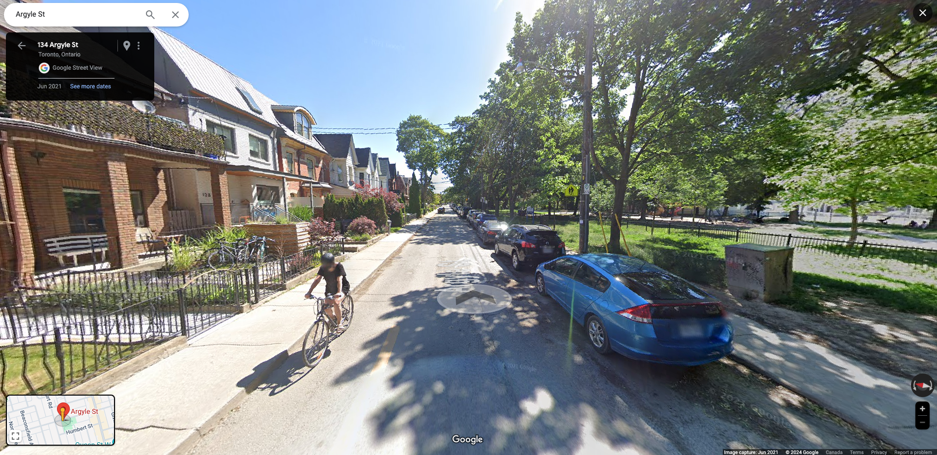
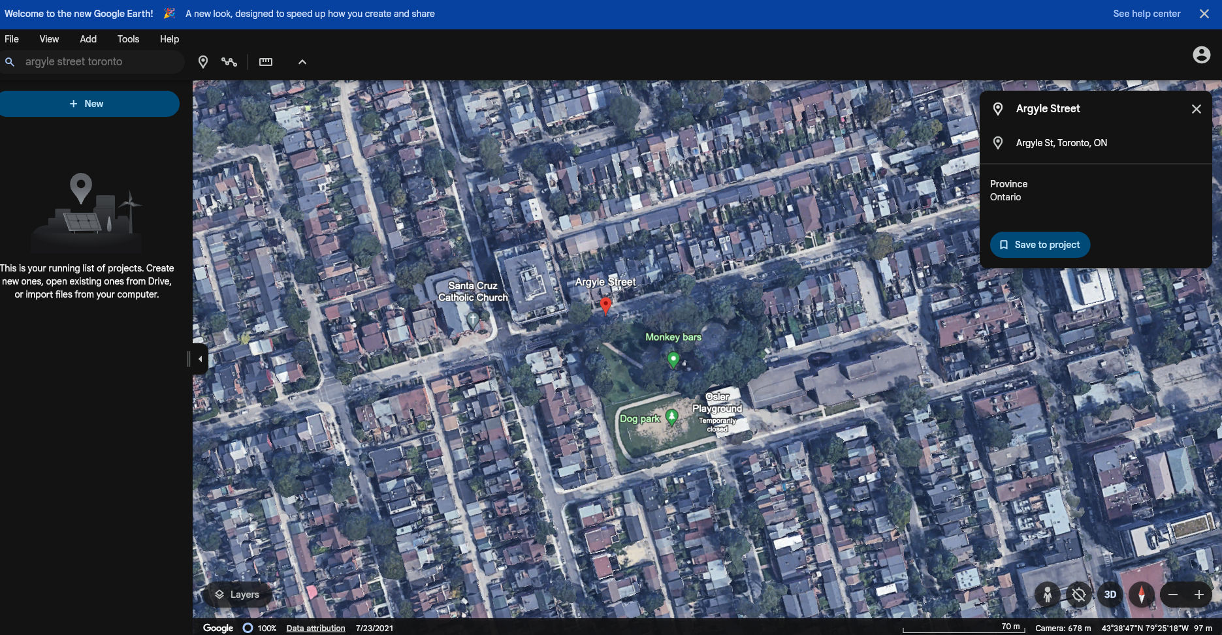

Methods (1): Verification of Installations and Upgrades

Slide 5



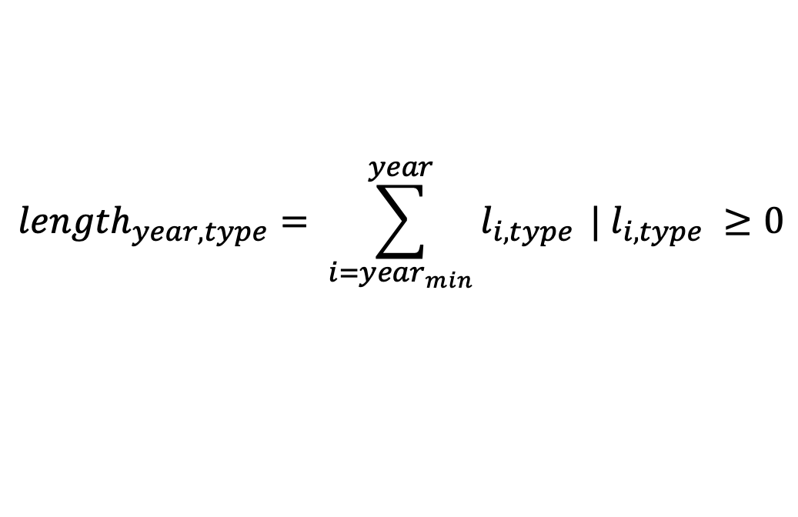
Methods (2): Calculations
Yearly Road Lengths
$${length}_{year, type}= \sum_{i={year}_{min}}^{year}{l_{i,type}} | l_{i,type} ≥0$$
Adjusted Yearly Road Lengths
$${length}_{year,type}^{install}+ {length}_{year,type}^{change}− {length}_{year,type}^{replacement}$$

Slide 6
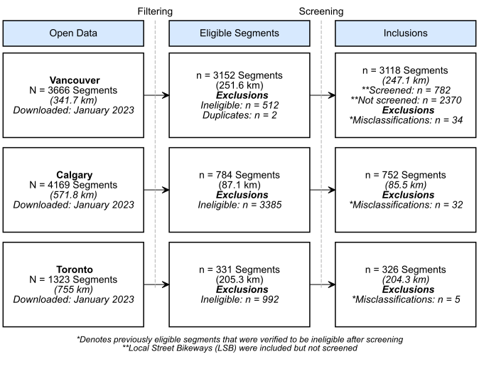
Results: Segment Inclusions and Exclusions
Painted Lanes (PL): solid/dashed lines separating cyclists from vehicle travel lanes, accompanied by signs or pavement markings to distinguish them as cycling routes
Buffered Lanes (BUF): painted lanes with wider painted areas marked with diagonal or chevron patterns
Cycle Tracks (CT): presence of a permanent vertical barrier such as bollards or raised curbs

Slide 7
Results: Installation Year Accuracy
42.1% Correct
62.7% ±1 Year
0 = Correct

Slide 8
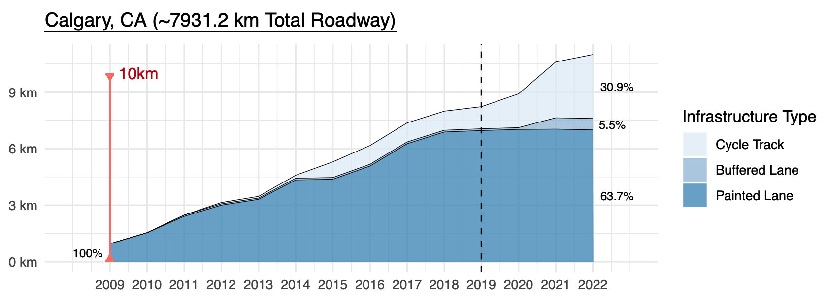
Results: Infrastructure per 1000 km of Roadway

Slide 9
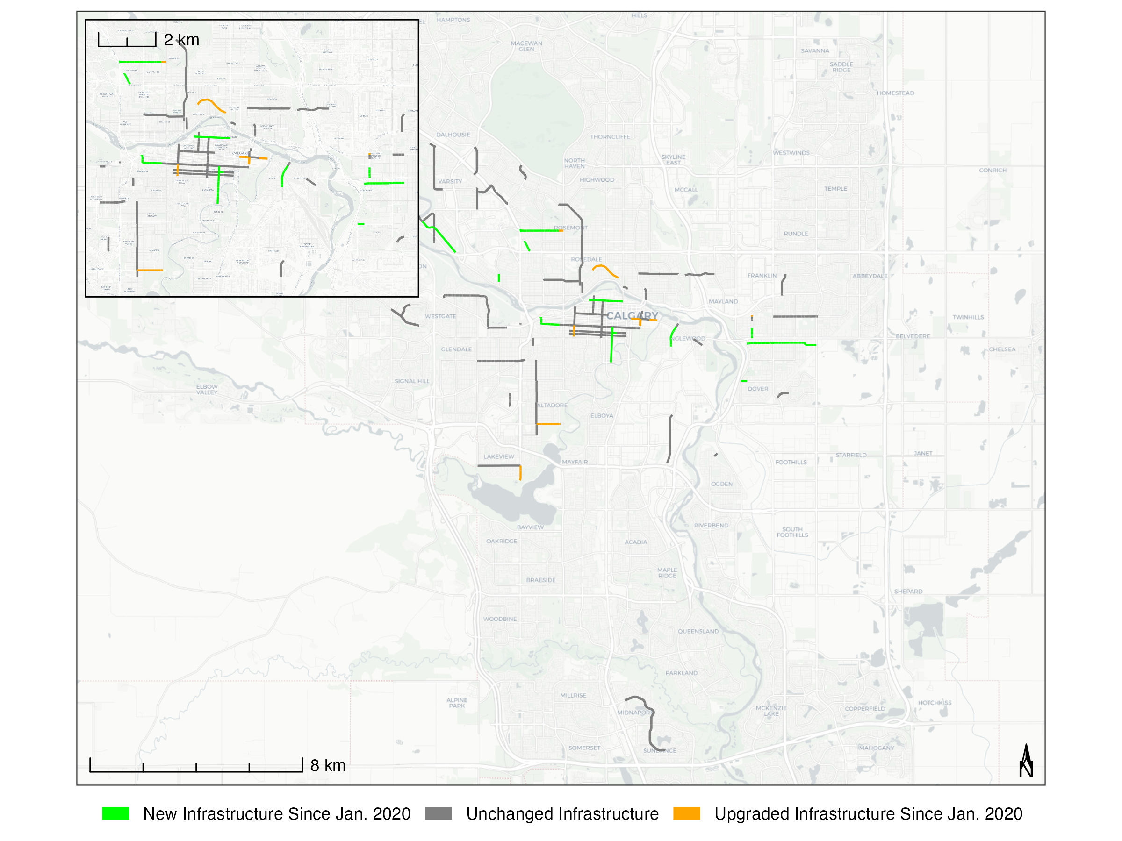
Results: Changes Since January 2020

Slide 10
Questions
Why the difference in installation years (42.1% Correct, 62.7% ±1 Year)?
Are there finer installation and upgrade dates than by year?
e.g. semesters, quarters, months, or day

Slide 11
Appendix: Net Change per 1000 km of Roadway

Slide 12
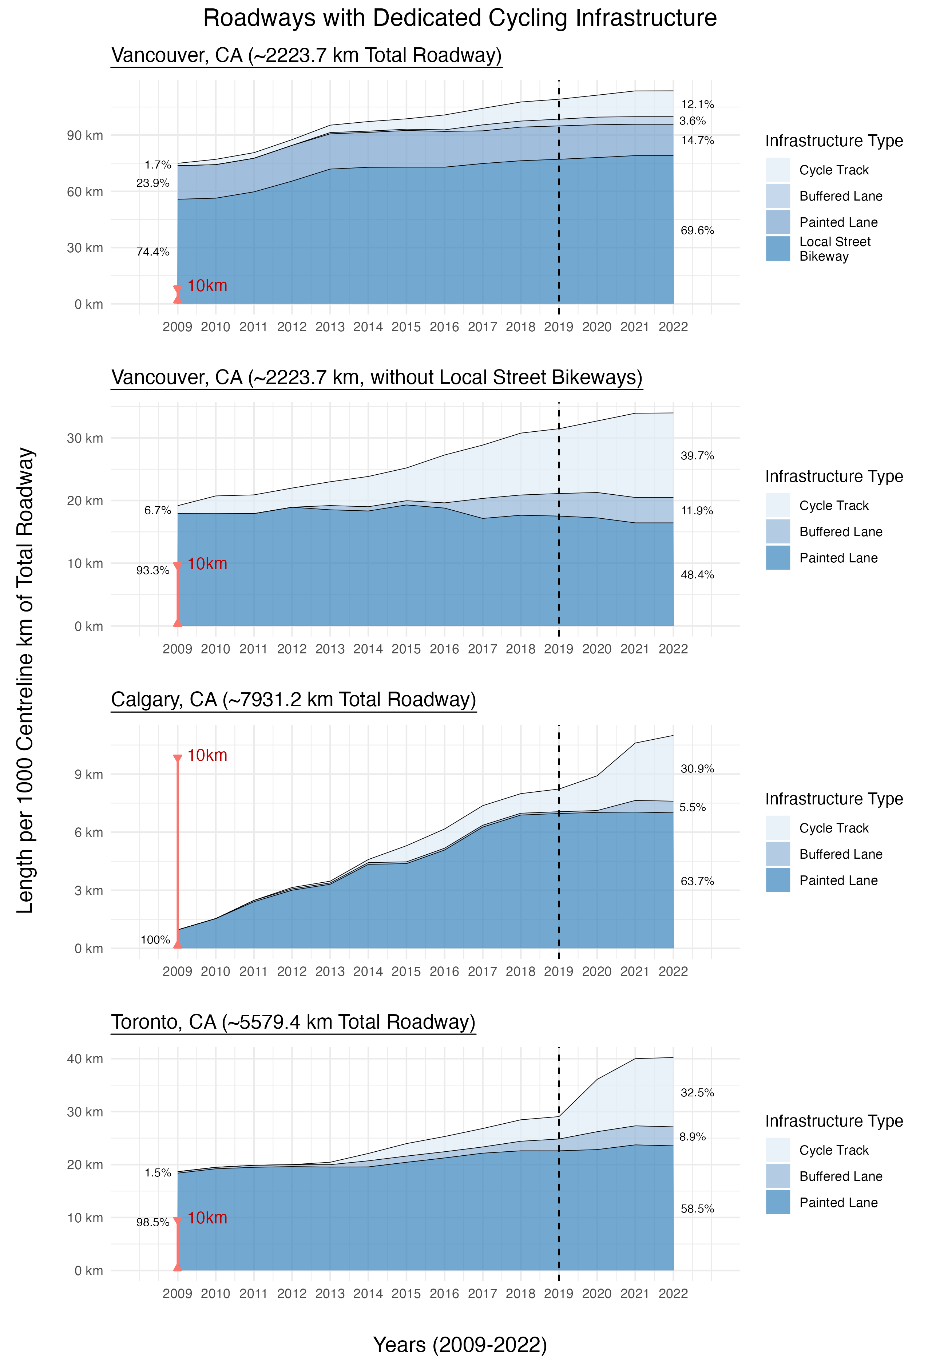
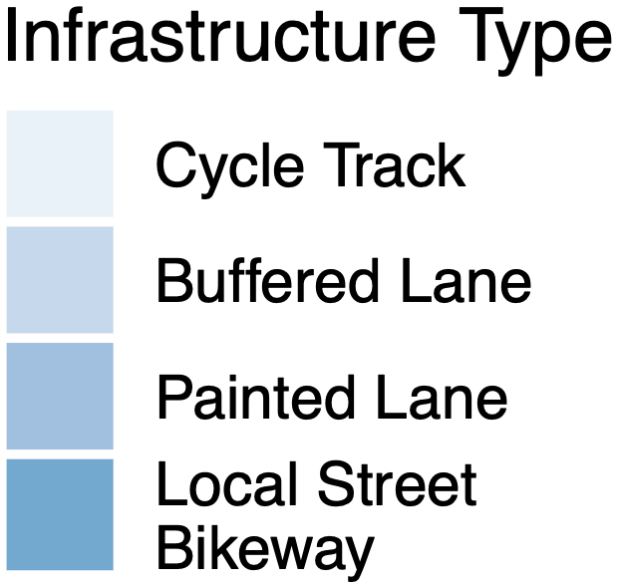
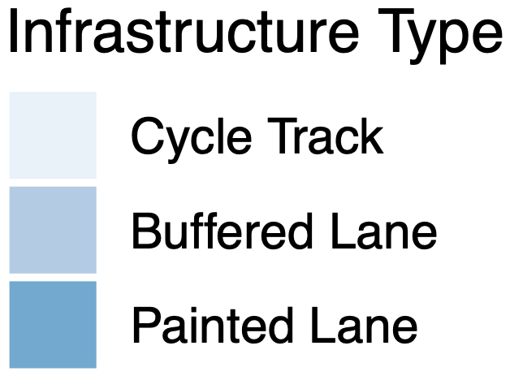
Appendix: Infrastructure per 1000 km of Roadway

